Slide 1
My Recent Senolytic and NAD+ Age Reversal Experiments
Ben Best
Pharmacy (BSc Pharm)
Physics/Computing Science (BSc)
Employee – Biomedical Research & Longevity Society

Slide 2
My Recent Self-Experimentation
(1) Fasting and exercise program to lose weight
(2) Enhanced senolytic therapy
(3) Enhanced NAD+ boosting therapy
  Plus enhanced NAD+ utilization
With multiple experiments in parallel, and experimental modification as the experiments precede, it is not easy to isolate specific causes and effects
These experiments are on top of my ongoing practices of a vegetarian ketogenic diet and many supplements

Slide 3
Fasting and Exercise
I gained a great deal of weight during the Spring due to the pandemic, reaching 147.5 lbs (66.9 kg)
I fast on weekends, eat one large meal only on Monday, Wednesday, and Friday, plus a couple of handfuls of nuts on Tuesday and Thursday.
I vigorously exercise on Tuesday, Thursday, and on the weekends.
My weight has dropped to below 125 lbs (56.7 kg)

Slide 4
Weight Loss and Blood Pressure
 | Weight (pounds) | Blood Pressure
May | 147.4 | 113/76
June | 141.6 | 109/73
July | 138.8 | 107/70
August | 134.8 | 110/73
September | 129.8 | 109/73
October | 128.0 | 103/68
November | 126.0 | 105/71

Slide 5
Senescent cells
  Senescent cells
  (1) no longer divide
  (2) resist apoptosis (programmed cell death)
  (3) secrete toxic chemicals (SASP factors)
    (SASP = Senescent-Associated Secretory Phenotype)
  (4) cause aging and aging-related diseases
    NATURE 571:183 (2019)

Slide 6
Justifying Senolytic Therapy (therapy to eliminate senescent cells)
  Senescent cells increase with age and underlie or worsen many age-related diseases, some of which are
    Atherosclerosis
    Loss of stem cell function
    Osteoarthritis
    Alzheimer’s disease
    Pulmonary fibrosis
    Age spots
    Cancer and spread of cancer
      NATURE 571:183 (2019)

Slide 7
Negative consequences of senescent cells
Senescent cells cease to benefit their resident tissues
Senescent cells remain metabolically active, producing high quantities of free radicals (reactive oxygen species)
  CELL DEATH & DIFFERENTIATION 26:276 (2019)
Senescent cells accumulate large amounts of cellular junk (lipofuscin)
  MOLECULES AND CELLS 33:597 (2012)
Senescent cells engulf neighboring cells, thereby increasing the survival of the bloated senescent cells
  JOUNAL OF CELL BIOLOGY 218:3827 (2019)
Senescent cells produce toxic SASP (Senescence-Associated Secretory Phenotype) factors
  CELL DEATH & DIFFERENTIATION 26:276 (2019)

Slide 8
Some negative consequences of SASP factors
SASP factors consist of inflammatory cytokines, growth factors, immune modulators and proteases
SASP factors produce chronic inflammation, induce fibrosis, inhibit stem cells, and cause cancer
  SCIENCE 364:636 (2019)
SASP factors induce insulin resistance
  DIABETOLOGIA 62:1835 (2019)
SASP factors reduce NAD+ in non-senescent cells (reducing PARP and sirtuin activity)
  BIOCHEMICAL AND BIOPHYSICAL RESEARCH COMMUNICATIONS 513:486 (2019)
SASP factors increase CD38 in macrophages (reduce NAD+)
  BIORXIV DOI:10.1101/609438 (2019)

Slide 9
Senolytic treatment
Senescent cells are very heterogeneous, such that any senolytic treatment that eliminates certain senescent cells will not affect others
  BMP Reports 52:47 (2019)
The ideal senolytic treatment drug uses a “hit-and-run” strategy, with a short half-life (a few hours) that is long enough to kill senescent cells, but does not remain around long enough to significantly harm non-senescent cells

Slide 10
Anti-anti-apototic senolytic treatment
Senescent cells, like cancer cells, are resistant to apoptosis (programmed cell death)
BCL family of proteins cause cells to resist apoptosis
  NATURE COMMUNICATIONS 7:11190:184 (2016)
Src tyrosine kinase also cause cells to resist apoptosis
  CELL DEATH AND DIFFERENTIATION 19:1459 (2012)

Slide 11
Dasatinib (D) and Quercetin (Q) as senolytics
Flavonoids (Fisetin, Quercetin) (Q) inhibit anti-apoptotic BCL proteins
  JOURNAL OF INTERNAL MEDICINE 288:518 (2020)
Dasatinib (D) inhibits anti-apoptotic Src tyrosine kinase
  JOURNAL OF INTERNAL MEDICINE 288:518 (2020)
Dasatinib and Quercetin eliminate different types of apoptosis-resistant senescent cells
  Dasatinib: eliminates senescent adipose progenitors
  Quercetin: eliminates senescent endothelial cells
  AGING CELL 18: e12950 (2019)
The combination Dasatinib+Quercetin (D+Q) kills more types of senescent cells than either D or Q alone
  AGING 9:955 (2017)
D+Q also kills non-senescent cells
  CELL RESEARCH 30:556 (2020)

Slide 12
D+Q trials in humans
Diabetic kidney disease is associated with increased numbers of senescent cells. Nine patients who were treated with D+Q over 3 days showed reduced senescent cells after 11 days
  EBIOMEDICINE 47:446 (2019)
Idiopathic pulmonary fibrosis is associated with accumulated senescent cells. Thirteen patients treated over 3 weeks with D+Q showed substantial reduction in symptoms
  EBIOMEDICINE 40:554 (2019)

Slide 13
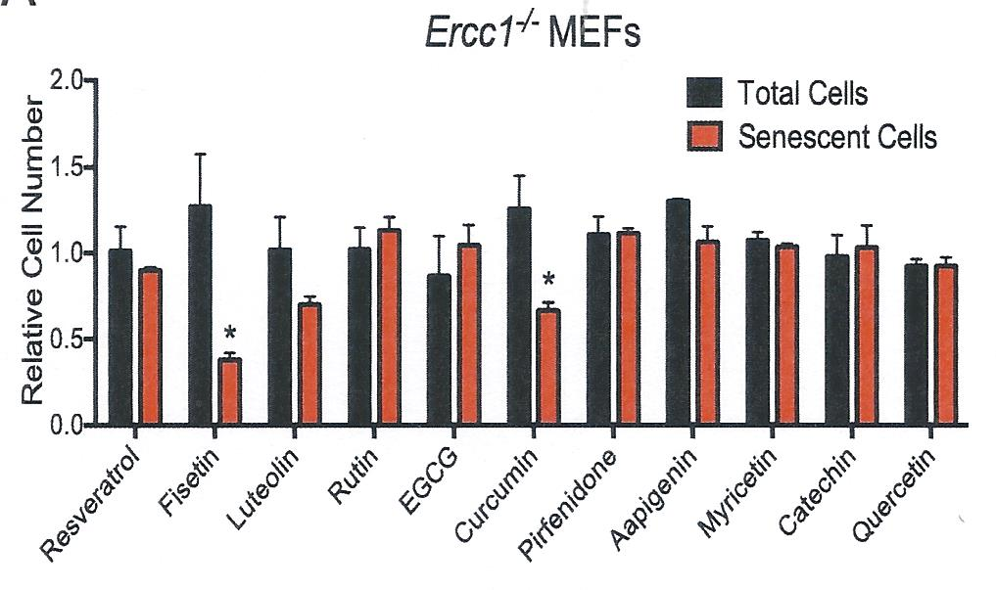
Fisetin
Fisetin has been shown to be superior to nine other flavonoid compounds (including quercetin) at eliminating senescent cells
  EBIOMEDICINE 36:18 (2018)
Fisetin given to 20-month-old mice extended lifespan 8% EBIOMEDICINE 36:18 (2018)

Slide 14
My Most Recent Senolytic Protocol
Every Monday for six weeks (Early SEP to mid-NOV)
  Dasatinib 2 x 50mg capsules (100 mg)
  Quercetin 4 x 250mg capsules (1 gram)
  Fisetin 15 x 100mg capsules (1.5 gram)
Take with high-fat meal to increase absorption
  of dasatinib Prague Medical Report 2-3:52 (2019)
  of quercetin Nutrients 11:2288 (2019)
No food or NAD+-boosting supplements on weekends in order to reduce NAD+
  NAD+ benefits senescent cells as well as normal cells
  Therefore keep NAD+ low to kill senescent cells
    Rejuvenation Research 22:261 (2019)

Slide 15
Inflammatory markers before and after 6 weeks of senolytic therapy
Inflammation Marker | BEFORE | AFTER
TNF-α (pg/mL) | 1.1 | 1.2
IL-8 (pg/mL) | 40.7 | 27.8
C-Reactive Protein (mg/L) | 0.56 | 0.49

Slide 16
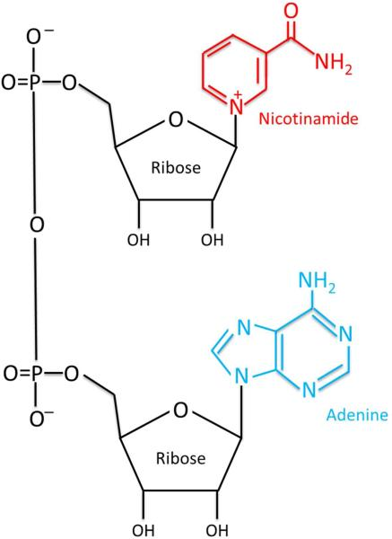
NAD+
Nicotinamide Adenine Di-nucleotide
  Two nucleotides (nucleobase+ribose+phosphate)
  Nicotinamide attached to one ribose+phosphate
  Adenine attached to the other ribose+phosphate

Slide 17
NAD+ declines with age
  Decline of NAD+ with age is reputedly responsible for many aging-related diseases: neurodegenerative diseases, cardiovascular diseases, muscle atrophy, etc
    TRENDS IN MOLECULAR MEDICINE 23:899 (2017)
  Restoration of NAD+ can potentially rejuvenate

Slide 18
NAD+ is a coenzyme with 3 main target enzymes
  (1) Poly (ADP-Ribose) Polymerase (PARP)
    Important for DNA repair
    CELL METABOLISM 27:529 (2018)
  (2) Sirtuins
    EXPERIMENTAL GERONTOLOGY 134:110888 (2020)
  (3) cADPR synthase
    cyclic ADP Ribose
    Ca²⁺ second messenger
      Muscle contraction, insulin secretion, cell proliferation
      WORLD JOURNAL OF BIOLOGICAL CHEMISTRY 5:58 (2014)

Slide 19
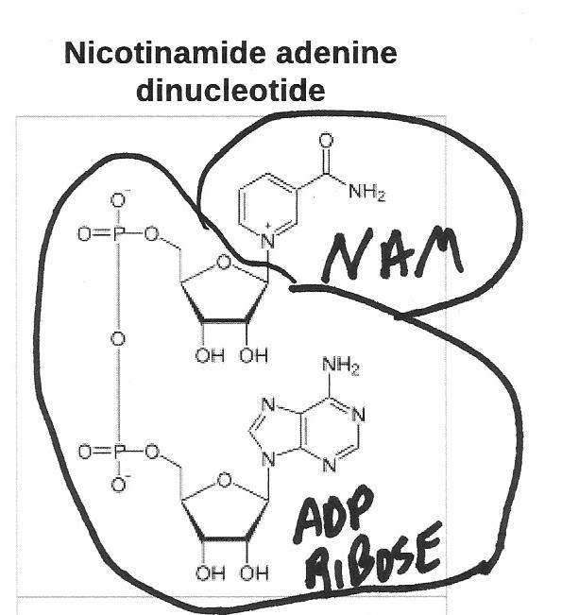
NAD+ as a cofactor results in NAM as a waste product
Splitting of NAD+ as enzymatic co-factor for PARP

Slide 20
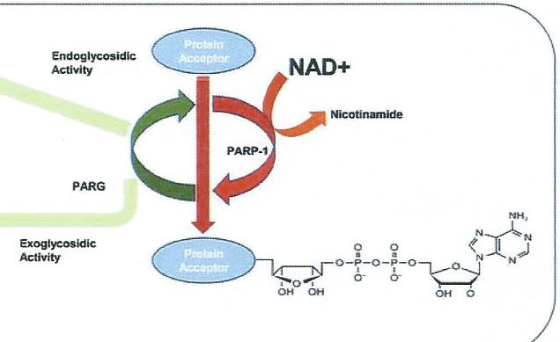
MARPs and PARPs
Mono (ADP-ribose) Polymerases (MARPs) and Poly (ADP-ribose) Polymerases (PARPs)

Slide 21
PARPs and the Genome
PARPs maintain genome stability
  NUCLEIC ACIDS RESEARCH 35:7456 (2007)
80-85% of DNA-break repair is mediated by PARP1 and 10-15% by PARP2
  CURRENT PROTEIN AND PEPTIDE SCIENCES 17:705 (2016)
A study of 13 mammalian species showed strong positive correlation between PARP activity and lifespan. Human PARP activity is 5 times rat activity
  PNAS 89:11759 (1992)
PARP activity declines with age
  NUCLEIC ACIDS RESEARCH 35:7456 (2007)

Slide 22
Sirtuins
Seven human sirtuins have been found
  SIRT1 to SIRT7
  Function by either deacylation or by mono-ADP ribosylation (MARP)
    BIOGERONTOLOGY 18:447 (2017)
Sirtuins are important for
  Stem cell function AGING CELL 16:1208 (2017)
  DNA Repair SCIENCE 350:1208 (2015)
  Mitochondrial function
    For heart (cardiovascular disease)
      CIRCULATION RESEARCH 123:868 (2018)
    For brain (neurodegenerative disease)
      JOURNAL OF CHEMICAL NEUROCHEMISTRY 95:43 (2019)

Slide 23
Sirtuins
Sirtuins are increased in calorie restriction, believed to be an important cause of the increase in health and lifespan
  BIOGERONTOLOGY 18:447 (2017)
SIRT1 induces mitochondrial biogenesis and antioxidants
  ANTIOXIDANTS & REDOX SIGNALING 28:711 (2018)
SIRT1 inhibits NF-kB, reducing chronic inflammation (cause of numerous age-related diseases) and promotes autophagy
  BIOGERONTOLOGY 18:447 (2017)
SIRT3 facilitates mitochondrial function and promotes autophagy
  INTERNATIONAL JOURNAL OF MOLECULAR SCIENCES 21:5266 (2020)
SIRT7 maintains ribosomal DNA thereby reducing cellular senescence
  JOURNAL OF BIOLOGICAL CHEMISTRY 298:11242 (2018)

Slide 24
Sirtuin 6 (SIRT6) reduces DNA damage
Transposon activity is implicated in many age-related disorders, including cancer and neurodegeneration
SIRT6 represses retrotransposon activity, but this repression declines with age along with declining SIRT6
  NATURE COMMUNICATIONS 5:5011 (2015)
SIRT6 facilitates PARP activity in DNA repair
  CELL 177:622 (2019)
SIRT6 maintains stem cell self-renewal capacity
  TRENDS IN ENDOCRINOLOGY AND METABOLISM 28:168 (2017)
Comparing 20 rodent species (mouse 2-3 years, beaver up to 20 years), lifespan was highly correlated with double-strand break repair capability and the capacity of SIRT6 to promote double-strand break repair.
  Beaver SIRT6 gene extended fruit fly lifespan more than mouse SIRT6 gene
  CELL 177:622 (2019)

Slide 25
CD38 (cADPR synthase)
  “CD” = “Cluster of Differentiation”
  CD is a protocol to identify cell surface molecules
  Example: CD34+,CD31– identifies stem cells
    (CD34 present, CD31 absent)
  Historically CD38 was simply a marker of T-cells
  CD38 is now known to be an enzyme on T-cells and macrophages that consumes NAD+
  CD38 can induce beneficial acute inflammation against bacterial infection
    NATURE MEDICINE 7:1209 (2001)

Slide 26
CD38 the major cause of NAD+ decline with age
Prior to 2016 it was believed that NAD+ declined with age mainly due to NAD+ consumption by PARP to repair the increasing age-associated DNA damage
  PLOS ONE 7:e42357 (2012)
Now known that aging is associated with increased visceral fat, which becomes infested with CD38-laden macrophages causing chronic inflammation
  GERONTOLOGY 57:66 (2010)
Secretions from senescent cells increases macrophages (further increasing chronic inflammation with age)
  BIOCHEMICAL AND BIOPHYSICAL RESEARCH COMMUNICATIONS 513:486 (2019) & NATURE METABOLISM 2:1265 (2020)
CD38 is the major cause of NAD+ decline with age
    CELL METABOLISM 23:1127 (2016)

Slide 27
Chronic inflammation versus
(anti-bacterial) acute inflammation
CD38 chronic inflammation can induce
  Rheumatoid arthitis
    CELLS 9:52 (2020)
  Asthma and COPD (CD38 elevated in heavy smokers)
    CURRENT OPINION IN PHARMACOLOGY 51:29 (2020)
    PHARMACOLOGY & THERAPEUTICS 172:116 (2017)
  Neuroinfammation and neurodegenerative diseases
    CELLS 9:471 (2020)
  Cellular senescence
    IMMUNOMETABOLISM 2:e200026 (2020)
Chronic inflammation in visceral fat activates CD38 in macrophages leading to NAD+ decline
  NATURE METABOLISM 2:1265 (2020)

Slide 28
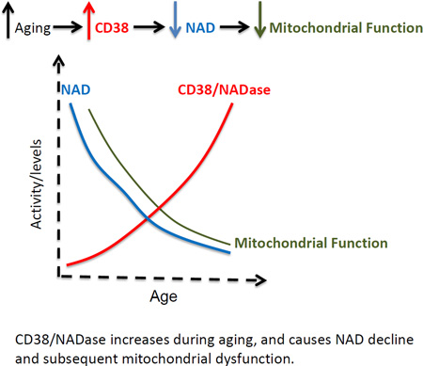
CD38 the major cause of NAD+ decline with age (declining mitochondrial function and DNA repair)

Slide 29
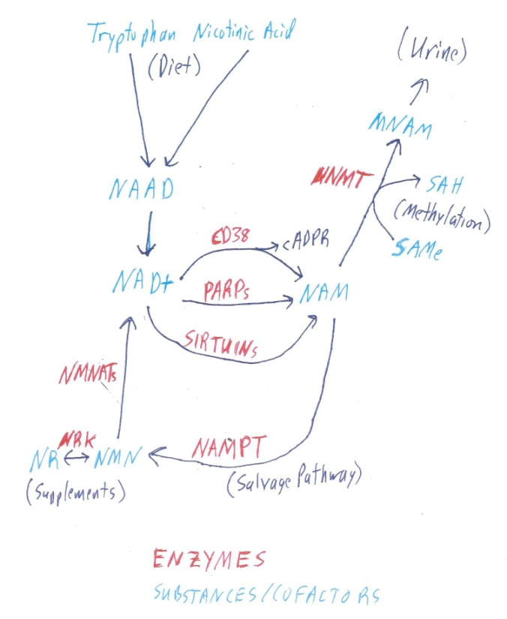
NAD+ Biochemical Pathways

Slide 30
NR & NMN supplement
Nicotinamide Riboside (NR) and Nicotinamide MonoNucleotide (NMN) can be taken as supplements to increase NAD+
Both NR & NMN are degraded into NAM in the bloodstream within minutes by CD38
  TRENDS IN BIOCHEMICAL SCIENCES 45:858 (2020)
  CELL METABOLISM 27:1067 (2018)
NAM quickly crosses cell and mitochondrial membranes and is converted to NAD+ by the NAMPT enzyme of the salvage pathway
  CELL METABOLISM 27:529 (2018)
  SIGNAL TRANSDUCTION AND TARGETED THERAPY 5:227 (2020)
So both NR & NMN are effective given as supplements

Slide 31
Some NR/NMN Animal Studies
NR (human equivalent 1.9 grams/day) given to 700 day-old mice improved mitochondrial and stem cell function and increased average lifespan from 829 days to 868 days
  SCIENCE 352:1436 (2016)
  Conversion of mouse to human dose divide grams/kg by 12.3
    FASEB Journal 22:659 (2008)
12 months of NMN (human 1.4 grams/day) to middle-aged mice improved insulin sensitivity, eye function and other age-related pathologies
  CELL METABOLISM 24:795 (2016)
NR (human equivalent 1.9 grams/day) given to mice fed a high-fat diet showed improved insulin sensitivity and mitochondrial function
  CELL METABOLISM 15:838 (2012)

Slide 32
SomeNR/NMN Human Studies
NR randomized/crossover supplementation to healthy middle-aged or older humans in a clinical trial boosted NAD+, reducing blood pressure and arterial stiffness
  NATURE COMMUNICATIONS 9:1286 (2018)
NR randomized supplementation to healthy middle-aged adults receiving 100mg, 300mg or 1000mg on 3 test days, separated by one-week periods boosted NAD+ 12%, 46%, and 46%
  NATURE COMMUNICATIONS 7:12948 (2016)

Slide 33
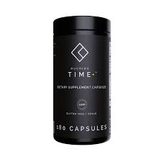
Nuchido TIME+ supplement
Developed by Nichola Conlon, PhD
Nuchido TIME+ boosts NAD+ by effects on 3 different enzymes

Slide 34
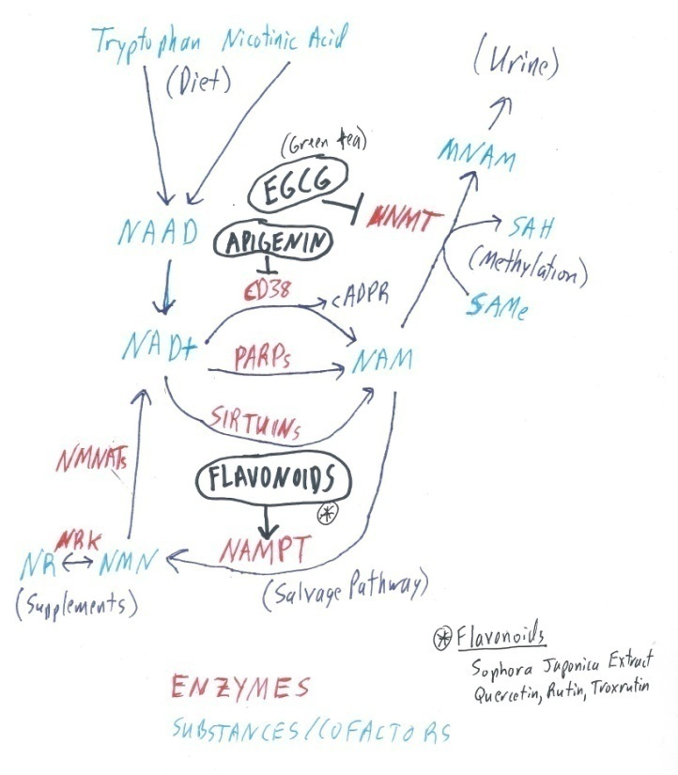
Nuchido TIME+ ingredients/actions

Slide 35
Nuchido TIME+ ingredients/actions
Apigenin and Quercetin inhibit CD38. Apigenin inhibits CD38 about one-third more than Quercetin
  DIABETES 62:1084 (2013)
Epigallocatechin gallate (EGCG) and other grape-seed extracts stimulate NAMPT enzyme
  SCIENTIFIC REPORTS 5:10954 (2015)
I cannot find a citation of a component of TIME+ inhibiting NNMT
NNMT is primarily active in liver, but also in adipose tissue, being beneficial in the liver, but harmful in adipose tissue
  CELL METABOLISM 2:200 (2015)
NNMT cannot cause methyl donor depletion in the liver because of high levels of activity of many liver methyl donors
  NATURE MEDICINE 21:887 (2015)
[Note: Aerobic and resistance exercise increase skeletal muscle NAMPT, and can elevate levels in older (over 54) exercisers to levels seen in younger (under 36) exercisers]
  PHYSIOLOGICAL REPORTS 7:e14139 (2019)

Slide 36
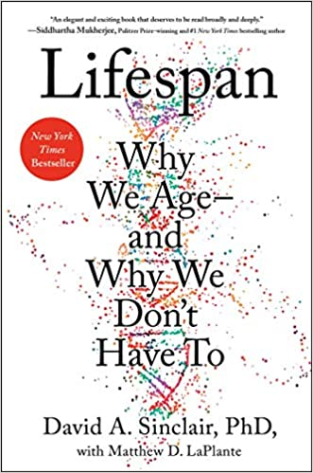
LIFESPAN by David Sinclair, PhD
Acclaimed by some to be the best anti-aging book since Aubrey de Grey’s ENDING AGING
Dr. Sinclair (world NAD+ expert) writes that he takes one gram of NMN and one gram of resveratrol daily

Slide 37
Resveratrol
Resveratrol is the most potent natural molecule that activates SIRT1
  MOLECULES 25:4554 (2020)
  Some synthetic molecules are more potent activators
    OXIDATIVE MECIDNE AND CELLULAR LONGEVITY 2019:8765954 (2019)
Resveratrol mainly activates SIRT1, but can also increase activity of SIRT3 and SIRT5
  PHARMACOLOGY & THERAPEUTICS 188:140 (2018)

Slide 38
Resveratrol
Ingested resveratrol is converted to sulphate conjugates in humans within 30 minutes, but the metabolites have a half-life over nine hours and may themselves be effective
  NATURE REVIEWS DRUG DISCOVERY 5:493 (2006)
Overweight human adults given 200mg/day resveratrol for 26 weeks showed decreased body fat, HbA1c (glycated hemoglobin), and increased hippocampal functional connectivity
  THE JOURNAL OF NEUROSCIENCE 34:7862 (2014)
  320 mg of quercetin was included to reduce resveratrol sulphonation
    XENOBIOTICA 30:857 (2000)
Resveratrol has been shown to extend maximum lifespan of killifish 59%, but whether sulphonation occurs in killifish is unknown
  CURRENT BIOLOGY 16:296 (2006)

Slide 39
My Most Recent NAD+ Protocol
Monday to Friday with meal
  Nicotinamide Riboside (NR) 4 x 250mg capsules (1 gram)
  Nicotinamide MonoNucleotide (NMN) 8 x 125mg capsules (1 gram)
  Optimized Resveratrol (Life Extension) 2 x 250mg capsules (1 gram)
    150 mg quercetin per capsule
    10 mg fisetin per capsule
  Nuchido TIME+ x 6
Evaluation of results? N=1, no control group
No readily available commercial test for assessing blood or tissue NAD+ levels

