Slide 1
Ketones for Healthy Longevity
Ben Best
Pharmacy (BSc Pharm)
Physics/Computing Science (BSc)
Employee – Biomedical Research & Longevity Society

Slide 2
Presentation Outline
(1) Ketogenic Diet Benefits
(2) Ketones: Chemistry, Biochemistry, and Physiology
(3) Exogenous Ketones

Slide 3
Ketogenic Diet Benefits

Slide 4
Ketogenic Diet For Epilepsy
Ketogenic diet developed as a treatment of last resort for drug resistant epilepsy cases, especially in children
80-90% fat, minimal carbohydrate
Carbohydrate means sugar or starchy food (not fiber)
Ketogenic means fats converted to ketones as a source of energy
JOURNAL OF CHILD NEUROLOGY 24:979 (2009)

Slide 5
Ketogenic Diet For Other Diseases
Nearly all cancer cells depend on glucose (from carbohydrate). A ketogenic diet starves cancer cells, slowing cancer growth
NUTRITION & METABOLISM 7:7 (2010)
Ketones can enter neurons directly, without the need of insulin, protecting from neurodegeneration
JOURNAL OF NUTRITION AND METABOLISM 2018:7195760 (2018)
Insulin resistant neurons starved for glucose implicated in Alzheimer’s and other neurodegenerative diseases. Ketones instead of glucose can supply energy to neurons
ENDOCRINOLOGY 152:3638 (2011)
Diabetics on a ketogenic diet show reduced insulin resistance and other markers of metabolic syndrome
LIPIDS 44:297 (2009)
NUTRITION 31:1 (2015)

Slide 6
Ketogenic (Low Carbohydrate) Diet Benefits
Carbohydrates promote lipid synthesis in the liver, raising blood triglycerides more than dietary fat
JOURNAL OF CLINICAL NUTRITION 97:2081 (1996)
AMERICAN JOURNAL OF CLINICAL NUTRITION 71:412 (2000)
FRONTIERS IN NUTRITION 9:861664 (2022)
High levels of triglycerides in the bloodstream leads to insulin resistance and diabetes
INTERNATIONAL JOURNAL OF MOLECULAR SCIENCES 21:6358 (2020)
High carbohydrate intake from starchy foods increased visceral fat, blood triglycerides, and metabolic syndrome
SCIENTIFIC REPORTS 5:16919 (2015)
High blood sugar from carbohydrates increases free radical production in mitochondria
ARCHIVES OF CARDIOVASCULAR DISEASE 113:736 (2020)

Slide 7
Ketogenic Diet for Longer Healthspan
A ketogenic diet increased median lifespan, slowed cognitive decline, and preserved motor function in mice
CELL METABOLISM 26:539 (2017)
A ketogenic diet reduced mid-life mortality and improved memory in aging mice
CELL METABOLISM 26:547 (2017)
A ketogenic diet has been shown to protect mice from coronavirus
ELIFE 10:e66522 (2021)

Slide 8
Unhealthy Ketogenic Diet Practices
Many people on a ketogenic diet think fried bacon and other fatty meats are health food
Advanced Glycation End-Products (AGEs) are formed from sugar, fats, and proteins exposed to high temperature
AGEs cause inflammation and oxidative stress
AGEs lead to diabetes, kidney disease, cardiovascular disease, neuropathy, cancer, neurodegenerative disease, etc
CELLS 11:1312 (2022)
FOOD | AGEs (kU/100 grams)
Fried Bacon | 91,577
Roasted Chicken | 18,520
Fried Beef Steak | 10,058
Roasted Walnuts | 7,887
Grilled Carrots | 226
Canned Carrots | 10

Slide 9
Animal versus Plant Fats
Saturated (animal) fat raises liver triglycerides increasing insulin resistance
NATURE REVIEWS: GASTROENTEROLOGY & HEPATOLOGY 18:770 (2021)
Saturated (animal) fats increase intestinal permeability (leaky gut)
THE BRITISH JOURNAL OF NUTRITION 124:654 (2020)
Animal fats are toxic to the insulin-producing cells of the pancreas (leading to diabetes)
JOURNAL OF MOLECULAR BIOLOGY 432:1514 (2020)
JOURNAL OF POPULATION THERAPEUTICS & CLINICAL PHARMACOLOGY 27:e22 (2020)

Slide 10
Persistent Organic Toxins in Fatty Food
Many organic pollutants are persistent in the environment, including both pesticides and industrial chemicals: PolyChlorinated Biphenyls (PCBs), organochlorine pesticides, digoxins, lindane, bisphenol A, phtalates, etc.
Persistent organic chemicals accumulate in the fats of the animals we eat, and thus accumulate even more in our fat
Pesticides are usually neurotoxic to insects, and to us
Pesticide exposure can increase the risk of Parkinson’s Disease up to 7-fold
ENVIRONMENTAL HEALTH PERSPECTIVES 112:950 (2004)

Slide 11
Toxins in Meat
Nitrates in processed meats (sausages,salami,bacon) have been shown to cause insulin resistance and atherosclerosis. Red meat increases risk of ischemic stroke.
PNAS 75:233 (2017)
TMAO (TriMethylAmine N-Oxide, unpleasant odor of rotting fish) contributes to atherosclerosis. Intestinal microbiota produce TMAO from meat in meat-eaters, but not in vegetarians who are experimentally fed meat.
NATURE MEDICINE 19:576 (2013)
DDT was banned in the US in 1972, PCBs (PolyChlorinated Biphenyls) were banned in 1979, but harmful pesticide use continues and these organic substances persist in fat tissue of animals and bioaccumulate in the fat of humans that eat meat
PCBs substantially increase TMAO formation in the liver
JOURNAL OF NUTRITIONAL BIOCHEMISTRY 33:145 (2016)

Slide 12
Healthy Ketogenic Diet Practices
Avoiding carbohydrates should not mean avoiding fiber
Dietary fiber can be transformed into the beneficial short-chain fatty acid butyrate in the colon
Butyrate is the main energy source for colon cells
Dietary fiber reduces the risk of obesity and insulin resistance
Dietary fiber reduces the risk of colon cancer
NUTRIENTS 9:1348 (2017)
Mice with extended healthspan on a ketogenic diet have not been dining on Kentucky Fried Chicken (AGEs)

Slide 13
Healthy Ketogenic Diet Practices
Get fat (and protein) from plants not animals
Olive oil
Avocado
Nuts
Seeds
Eat high-fiber foods (with healthy oils)
Avocado
Broccoli
Cauliflower
Leafy Greens
Lentils and other beans

Slide 14
89,224 California Seventh-Day Adventists American Journal of Clinical Nutrition 89:1607S (2009)
DIET | BMI | DIABETES | HYPERTENSION
Omnivores | 28.26 | 1.00 | 1.00
Pesco (Fish)-eating Vegetarian | 25.73 | 0.49 | 0.62
Lacto-ovo Vegetarian | 25.48 | 0.39 | 0.45
Vegan (no daiiry) | 23.13 | 0.22 | 0.25

Slide 15
Seventh-Day Adventists US & Canada NUTRIENTS 6:2131 (2014)
CAUSE OF DEATH | OMNIVORES | VEGETARIANS
CARDIOVASCULAR
Male | 1.00 | 0.71
Female | 1.00 | 0.99
CANCER | 1.00 | 0.92
ALL CAUSES
Male | 1.00 | 0.82
Female | 1.00 | 0.93

Slide 16
Ketones: Chemistry, Biochemistry, and Physiology

Slide 17
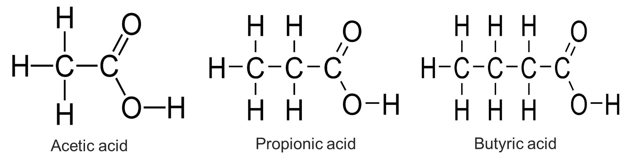
Short-Chain Fatty Acids (SCFAs)
Acetic acid (acetate) and propionic acid (propionate) are mostly absorbed into the bloodstream, but butyric acid (butyrate) mostly remains in the colon, providing 70% of energy for colon cells
INTERNATIONAL JOURNAL OF MOLECULAR SCIENCES 20:1214 (2019)
Colon cancer cells use glucose, not butyrate for energy, so the excess butyrate modifies gene expression arresting growth and kill cancer cells
INTERNATIONAL JOURNAL OF MOLECULAR SCIENCES 22:3061 (2020)

Slide 18
Short-Chain Fatty Acid (SCFA) benefits
SCFAs can inhibit inflammatory cytokines and lower blood pressure
INTERNATIONAL JOURNAL OF MOLECULAR SCIENCES 21:6356 (2020)
Butyrate induces the secretion of the hormones GLP-1 and PYY, reducing appetite and increasing insulin sensitivity
MOLECULES 26:682 (2021)
SCFAs, especially butryrate, increase colon mucin and tight-junction proteins, improving intestinal barrier (preventing “leaky gut”)
NUTRIENTS 10:1499 (2018)
Rats fed resistant starch had increased SCFA and 33% life extension
BRITISH JOURNAL OF NUTRITION 100:1192 (2008)
Elderly humans fed resistant starch for three months showed reduced Proteobacteria (Gram negative), increased healthy Bifidobacteria, and increased SCFA in their gut
CLINICAL NUTRITION 37:797 (2018)

Slide 19
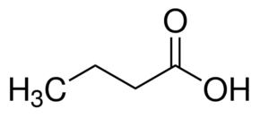
Butyric Acid (Butyrate) Structure (short-chain fatty acid produced in the colon from fiber)
Conventional stick-figure with Carbon atoms as corners and Hydrogen atoms hidden

Slide 20
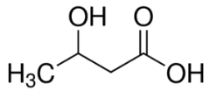
Beta-hydroxybutyrate (βHB) Structure
-OH (hydroxyl) in the beta position
The main “ketone body” in the blood stream

Slide 21
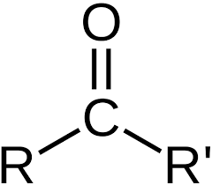
Ketone Structure
Carbon and Oxygen atoms shown, organic groups shown as R and R’

Slide 22
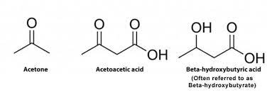
The Three Biological Ketones
Note that Beta-hydroxybutyrate is not literally a ketone because there is no carbon attached to an =O only attached to an R-group
Beta-hydroxybutyrate does not function as a ketone insofar as it is converted from AcetoAcetate and to AcetoAcetate for blood transport

Slide 23
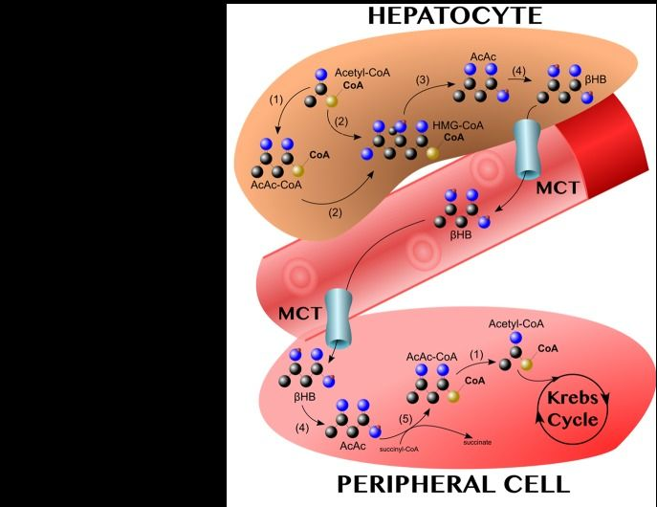
Ketone Biochemistry
Beta-hydroxybutyrate (βHB) made from AcetoAcetate in liver cells
Beta-hydroxybutyrate into bloodstream by the MCT transporter
Beta-hydroxybutyrate into non-liver cells (especially brain and skeletal muscle) by the MCT transporter
Beta-hydroxybutyrate converted to AcetoAcetate in non-liver cells for use as ketone fuel (and cell signaling)

Slide 24
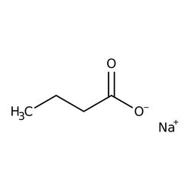
Beta-hydroxybutryrate Sodium Salt Structure
Sodium ion dissociates from the beta-hydroxybutryrate ion

Slide 25
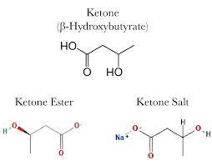
Ketone Ester versus Ketone Salt Stuctures
Sodium Salt shown

Slide 26
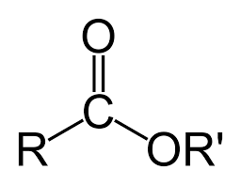
Ketone Ester Structure
Carbon and Oxygen atoms shown, organic groups shown as R and R’

Slide 27
Ketone Benefits
In addition to being an energy source, beta-hydroxybutyrate (βHB) has protective signaling properties
βHB lessens number of senescent cells and reduces SASP (Senescence-Associated Secretory Phenotype, which refer to toxic substances produced by senescent cells)
βHB inhibition of histone deacetylases induces neurogenesis and protects the nervous system from NF-kB inflammation
NUTRIENTS 13:3420 (2021)
FRONTIERS IN NUTRITION 6:63 (2019)
Ketones increase blood flow to the brain
THE AMERICAN JOURNAL OF PHYSIOLOGY 270:E746 (1996

Slide 28
Blood Ketone Levels (millimoles/Liter)
Normal ketone levels vary between 0.1 and 0.4 mmol/L
Nutritional ketosis defined as 0.4 to 1.0 mmol/L
Ketogenic diet (very low carbs) typically above 2 mmol/L
90 minutes intense exercise can raise ketones to 1-2 mmol/L
For weight loss 1.5-3.0 mmol/L
Recommended by Stephen Phinney and Jeff Volek
Some authorities put risk ketoacidosis as low as 3.0 mmol/L for diabetics
My ketones have reached levels above 5 mmol/L by eating butter, mayonnaise, or olive oil
I have reached ketone levels of 7 mmol/L during a weeklong water fast

Slide 29
Exogenous Ketones

Slide 30
Exogenous Ketone to Animals
Exogenous ketones lower blood glucose without elevating blood lipids
FRONTIERS IN PHYSIOLOGY 8:848 (2017)
βHB administered to nematode worms extends lifespan 20%
EXPERIMENTAL & MOLECULAR MEDICNE 52:548 (2020)
βHB ester given to rats resulted in a 1.7-fold decrease in blood glucose and a halving of blood insulin
IUBMB LIFE 69:305 (2017)
Rats fed ketone esters showed improved physical and cognitive performance
FASEB JOURNAL 30:4021 (2016)
Feeding ketone esters to mice substantially increases the number of mitochondria and insulin sensitivity
FASEB JOURNAL 26:2351 (2012)

Slide 31
Exogenous Ketone to Humans
Ketone salts can cause a gastrointestinal stress, not seen with ketone esters, although ketone esters have a bitter taste
BMC MEDICINE 19:313 (2019)
Ketone ester given to healthy young males decreased blood glucose and suppressed glucose production by about 20%
JOURNAL OF PHYSIOLOGY 596:1385 (2018)
Ketone ester drinks increase blood βHB levels 50% more than ketone salt drinks
FRONTIERS IN PHYSIOLOGY 8:848 (2017)
An exogenous βHB plus MCT mixture improved cognitive function in some, but not all, of a study of 13 male runners
NUTRITION & METABOLISM 17:81 (2020)
Ketone ester drinks suppress appetite in humans, although the effect may take as long as a few weeks
NUTRITION RESEARCH 77:1 (2020)

Slide 32
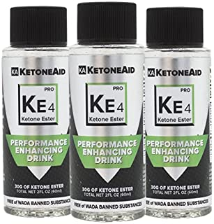
Ketone Ester Drink
2.5 grams ketone ester per 5 milliliters
Bitter taste
3 bottles for $104.95 on Amazon
60 milliliters per bottle

Slide 33
Blood values KE4 self-administration (Ben Best, April 30, 2022) (5 mL = 2.5 grams per hour) Total cost of experiment $23.32
Hour | 0 | 1 | 2 | 3 | 4 | 5 | 6 | 7 | 8
Glucose mg/dL | 103 | 101 | 94 | 94 | 91 | 91 | 85 | 85 | 80
β-HB mmol/L | 0.3 | 0.6 | 1.5 | 0.9 | 1.1 | 0.7 | 1.1 | 1.1 | 1.8

Slide 34

Ketone Ester Beverage
5.2 grams ketone esters per half-can
Pleasant taste, carbonated
$59/8-pack -- $295/50-pack ($5.90/can)

Slide 35
Blood values R 1,3 self-administration (Ben Best, May 3, 2022) (6 fluid ounces = 5.2 grams per hour) Total cost of experiment $33.19
Hour | 0 | 1 | 2 | 3 | 4 | 5 | 6 | 7 | 8 | 9
Glucose mg/dL | 109 | 98 | 92 | 88 | 90 | 81 | 79 | 76 | 70 | 72
β-HB mmol/L | 0.4 | 1.2 | 1.3 | 1.3 | 1.8 | 1.8 | 2.1 | 1.7 | 2.2 | 2.3

Slide 36
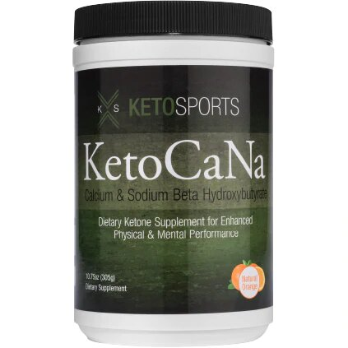
Ketone Salt Powder
5 grams net ketone salt/half-cup in water
Pleasant taste, no gastrointestinal distress
$67.50 per 305 gram jar (gross weight)

Slide 37
Blood values KetoCaNa self-administration (Ben Best, May 7, 2022) (5 grams per hour in half-cup water) Total cost of experiment $24.50
Hour | 0 | 1 | 2 | 3 | 4 | 5 | 6 | 7 | 8 | 9 | 10
Glucose mg/dL | 85 | 82 | 77 | 71 | 68 | 64 | 63 | 67 | 67 | 69 | 67
β-HB mmol/L | 0.7 | 0.8 | 1.9 | 0.9 | 0.9 | 0.9 | 1.4 | 0.6 | 1.4 | 1.6 | 0.9

Slide 38
Comments on Experiments
I fasted for the duration of all experiments, so some drop in blood glucose and rise in blood βHB would be expected
Note that I doubled the 2.5 grams ketones per dose given in the first experiment to 5 grams in the 2nd and 3rd experiments
The starting levels of glucose and ketone were different in each experiment
The ketone esters more dramatically raised blood βHB than the ketone salt, even in the first experiment which used only 2.5 grams of ketone
The only experimental results were blood glucose and βHB, so benefits must be surmised from the animal and human experiments presented

Slide 39
Concluding Remarks
I eat many berries, which prevents my diet from being completely ketogenic
Blueberries protect against cardiovascular disease
AMERICAN JOURNAL OF CLINICAL NUTRITION 109:1535 (2019)
Blueberries protect against cognitive decline
NUTRIENTS 14:1619 (2022)
I now believe that exogenous ketones can add to the benefit of a ketogenic diet
I intend to drink KE4 daily in 5 mL portions
The costs of exogenous ketones are easier to determine than the benefits
My blood tests should show improved biomarkers and reduced inflammation

Slide 40
QUESTIONS ???
QUESTIONS ????

